Slide 1


CS 235: User Interface Design January 22 Class Meeting
Department of Computer Science San Jose State University Spring 2015 Instructor: Ron Mak
www.cs.sjsu.edu/~mak

Slide 2
Basic Info
Office hours
TuTh 7:30 - 8:30 PM
MH 413
Class website
http://www.cs.sjsu.edu/~mak/
Green sheet
Assignments
Lecture notes

Slide 3
Goals of the Course
User interface (UI) design
Web applications
Mobile applications
Usability testing
UI evaluation
User experience (UX) design
Data visualization
Information displays
Dashboards

Slide 4
Design, Not Programming!
Create mock-ups and prototypes of applications.
Your application only has to “work” well enough to demonstrate its user interface.
Your final project will be a significant data visualization application.

Slide 5
Design Teams
Projects will be done by small design teams.
Projects may be broken up into assignments.
Form your own teams of 4 members each.
Choose your team members wisely!
Be sure you’ll be able to meet and communicate with each other and work together well.
No moving from team to team.
At least one member of each team should be comfortable using prototyping tools.

Slide 6
Project Teams, cont’d
Each team member will receive the same score on each team assignment and team project.
Each team email to ron.mak@sjsu.edu by Monday, January 26:
Your team name
A list of team members and email addresses
Subject: CS 235 Team Team Name
Example: CS 235 Team Super Coders

Slide 7
Individual Responsibilities
You are personally responsible for participating and contributing to your team’s work, and for understanding each part of the work for every assignment whether or not you worked on that part.

Slide 8
Postmortem Assessment Report
At the end of the semester, each student will individually turn in a short (one page) report:
A brief description of what you learned in the course.
An assessment of your personal accomplishments for your project team.
An assessment of each of your project team members. _

Slide 9
Individual Student’s Overall Class Grade
50% design assignments (team scores)
Demonstrate project work to the class.
Justify your design choices.
30% final project (team scores)
20% midterm (individual score)
Final letter grade based on the class curve.

Slide 10
Participation is Important
Can move your final grade up or down, especially in borderline cases.
Participation in class.
Participation in your team.
As reported by the postmortem assessment reports.

Slide 11
Take roll!

Slide 12
User Interface (UI)
What does user interface mean?
What makes a good user interface?

Slide 13
UI Constraints
Desktop/laptop vs. web vs. mobile applications
 | UI Constraints
Desktop/laptop | Practically none
Web | Limited by browser capabilities
Mobile | Limited by hardware capabilities and screen sizes

Slide 14
First Team Task
Imagine a web application that you would like to see developed.
Examples:
class scheduling
contact management
meal preparer
No games! _

Slide 15
First Team Task, cont’d
When you email your new team information, include:
A one-sentence description of your imagined application, and
Four features that you want your application to have. _

Slide 16
Application Example
A class scheduling application enables a student to choose and schedule his or her classes for the semester.
Four features?
Download class information from the school website.
Specify desired class times and breaks.
Display classes on a calendar.
Homework due date and exam date reminders. _

Slide 17
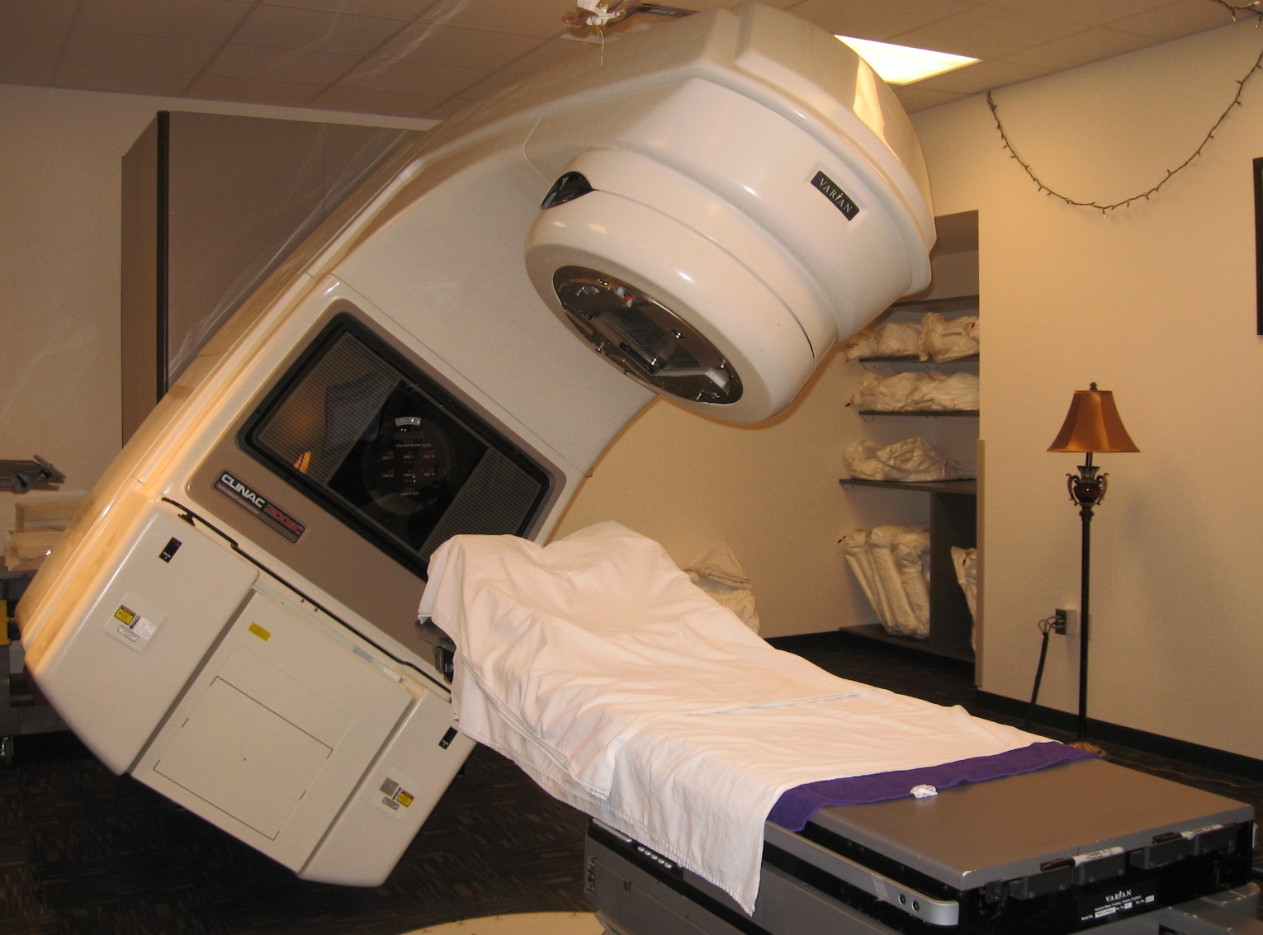
Real-World UI Example: Therac-25
Radiation therapy machine developed by Canadian and French companies.
Used 1985-1987.

Slide 18
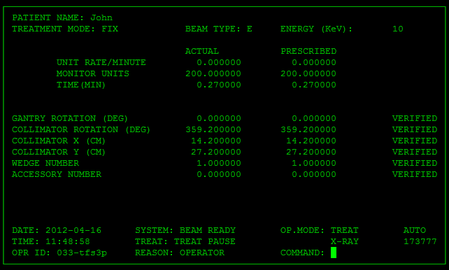
Therac-25: Text-Based User Interface

Slide 19
Therac-25: Error Handling
Whenever the system detected a problem:
Displayed the word MALFUNCTION.
Followed by an error code.
The user manual did not explain the error code.
Therefore, what do you think the operator did?
The operator overrode the system. _

Slide 20
Therac-25: Input Synchronization I
The UI got out of sync with the operator if the operator entered commands too quickly.
This problem was not detected during testing and initial use.
Why not?

Slide 21
Therac-25: Input Synchronization II
On a text screen, what should happen when you type over a character that is already displayed? _

Slide 22
Therac-25: Input Synchronization II, cont’d

Slide 23
Therac-25: Input Synchronization II, cont’d
The operator enters the wrong beam type code.
He or she corrects it on the screen by overtyping the incorrect code character with the correct code character.
The new beam type code character was displayed.
However, the software did not internally process the new character correctly but instead it kept the old code in its buffer. _

Slide 24
Therac-25: Tragic Results
Between 1985 and 1987, six patients were given 100 times the intended dose of radiation.
Three of those patients died from radiation burns.
What other UI features were missing that could have prevented these tragedies? _

Slide 25
User Experience (UX)
What does user experience mean?
What makes a good user experience? _

Slide 26
UX Example: The Apple iPhone
Set the iPhone to silent mode.
Incoming phone calls will vibrate instead of ring.
What happens when a preset alarm goes off? _

Slide 27
Usability Testing
How can we test whether or not our UI design or UX design is good? _

Slide 28
Data Visualization
Big Data + Big Data analysis
What is data visualization?
Present analyzed data in a useful and insightful way to the user.
Actionable knowledge! _

Slide 29
Reminders: By Monday, January 26
Form teams.
Email me your team information.
team name
team members and email addresses
Include a description of your team’s imagined web application.
1-sentence description
4 features _

